Slide 1


Object-Oriented Programming
Presentation for use with the textbook Data Structures and Algorithms in Java, 6th edition, by M. T. Goodrich, R. Tamassia, and M. H. Goldwasser, Wiley, 2014

Slide 2
Exceptions
2.4

Slide 3
Exceptions 1
Exceptions are unexpected events that occur during the execution of a program.
An exception might result due to an unavailable resource, unexpected input from a user, or simply a logical error on the part of the programmer.

Slide 4
Exceptions 2
In Java, exceptions are objects that can be thrown by code that encounters an unexpected situation.
An exception may also be caught by a surrounding block of code that “handles” the problem.
If uncaught, an exception causes the virtual machine to stop executing the program and to report an appropriate message to the console.

Slide 5
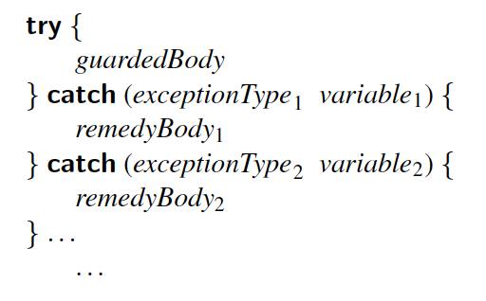
Catching Exceptions 1
The general methodology for handling exceptions is a try-catch construct in which a guarded fragment of code that might throw an exception is executed.

Slide 6
Catching Exceptions 2
If it throws an exception, then that exception is caught by having the flow of control jump to a predefined catch block that contains the code to apply an appropriate resolution.
If no exception occurs in the guarded code, all catch blocks are ignored.

Slide 7
Catching an Exception
try
{
statement
statement
. . .
}
catch(ExceptionClass exceptionObject)
{
statement
statement
. . .
}

Slide 8
Exceptions Example
Open up sourcecode with BlueJ
find package dsaj.design
open
file ExceptionDemo.java

Slide 9
Throwing Exceptions 1
Exceptions originate when a piece of Java code finds some sort of problem during execution and throws an exception object.
This is done by using the throw keyword followed by an instance of the exception type to be thrown.

Slide 10
Throwing Exceptions 2
It is often convenient to instantiate an exception object at the time the exception has to be thrown. Thus, a throw statement is typically written as follows:
throw new exceptionType(parameters);
where exceptionType is the type of the exception and the parameters are sent to that type’s constructor.

Slide 11
Throwing an Exception
throw exceptionObject;

Slide 12
Throwing an Exception
Can be constructed with an error message
if (amount > balance)
{
throw new IllegalArgumentException(
“Amount exceeds balance”);
}
balance = balance – amount;
Not executed when the exception is thrown
A new Exception object is constructed then thrown

Slide 13
The throws Clause 1
When a method is declared, it is possible to explicitly declare, as part of its signature, the possibility that a particular exception type may be thrown during a call to that method.
The syntax for declaring possible exceptions in a method signature relies on the keyword throws (not to be confused with an actual throw statement).

Slide 14
The throws Clause 2
For example, the parseInt method of the Integer class has the following formal signature:
public static int parseInt(String s) throws NumberFormatException;

Slide 15
Throws Clause
public void readData(String fileName)
throws FileNotFoundException,
NumberFormatException
You may also list unchecked exceptions
You must specify all checked exceptions that this method may throw

